Slide 1
Minimum Spanning Tree (MST) for Optimizing Pollution Monitoring Networks 🌲 Foundations of Data Science 1501564 – Final Project
Aaesha Saleh Abdulrahman BinDarwish Alteneiji - U24102490
Ahuod Yousuf Mohammad Hassan Albalooshi - U24105514
Kulsum Ameen Ahmed Ameen - U24200613
Ghalya Abdalla Mohammad Bakhit Almesafri - U24200486
Done by :
GeoDevelopers Team

Slide 2

Introduction
Focus: Optimize air pollution monitoring using real-world data
Dataset: 121 sensor locations across Chicago (since July 2021)
Parameters: PM2.5, O₃, NO₂, CO, temperature, humidity, etc.
Challenges: Large, geo-referenced, complex dataset

Slide 3
Objective
To create a smart and low-cost pollution monitoring network using Minimum Spanning Tree (MST) algorithms.
The goal is to place sensors in the best possible locations so we can cover the whole area, reduce costs, and collect accurate pollution data.

Slide 4
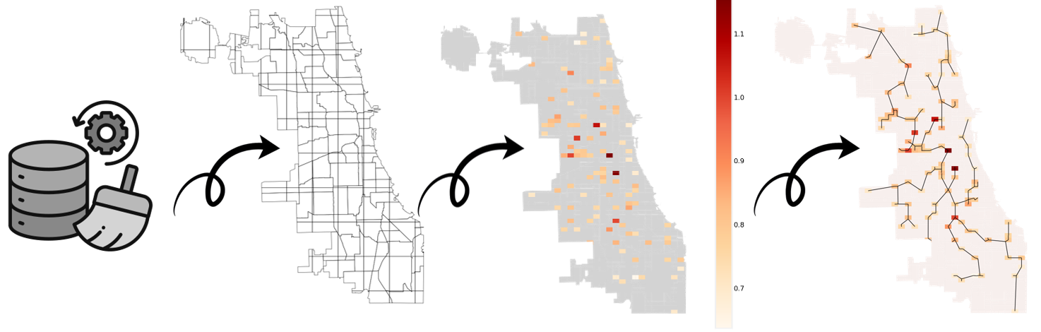
Methodology
Collecting and cleaning data
Grouping and sampling data
Clustering data
Minimum Spanning Tree
Sensors Optimizing suggestion

Slide 5
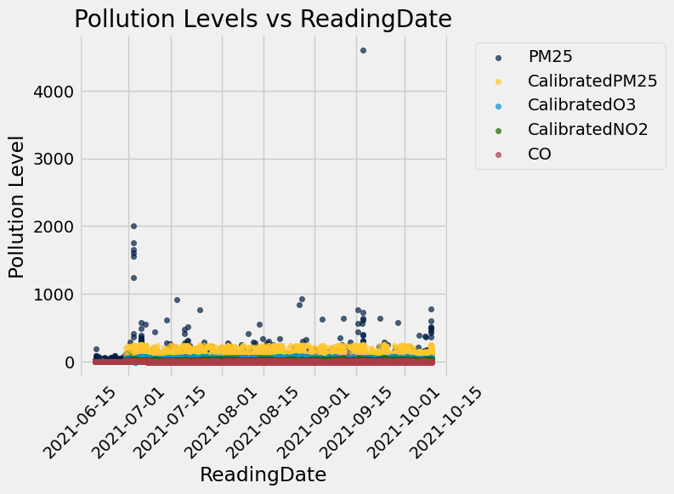
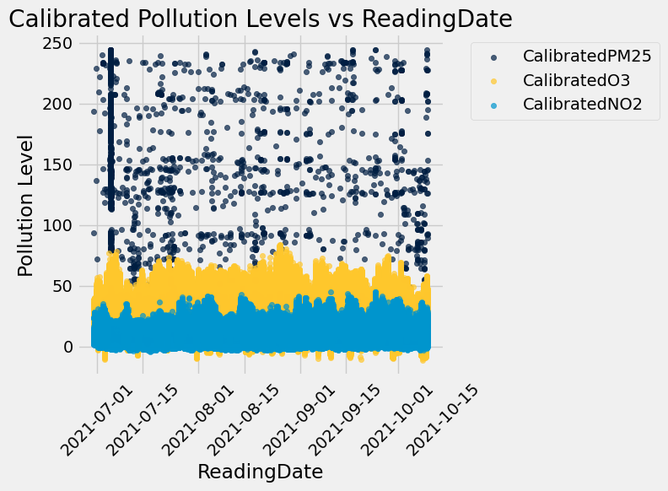
Results

Slide 6
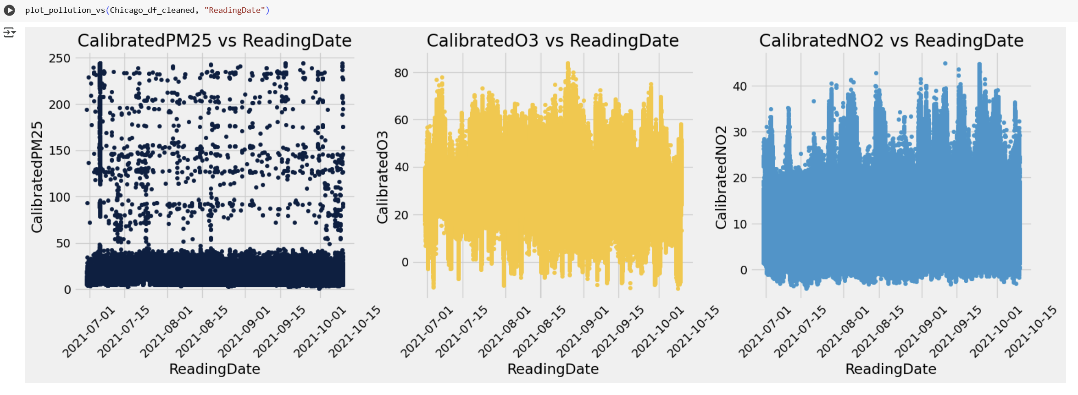
Results

Slide 7
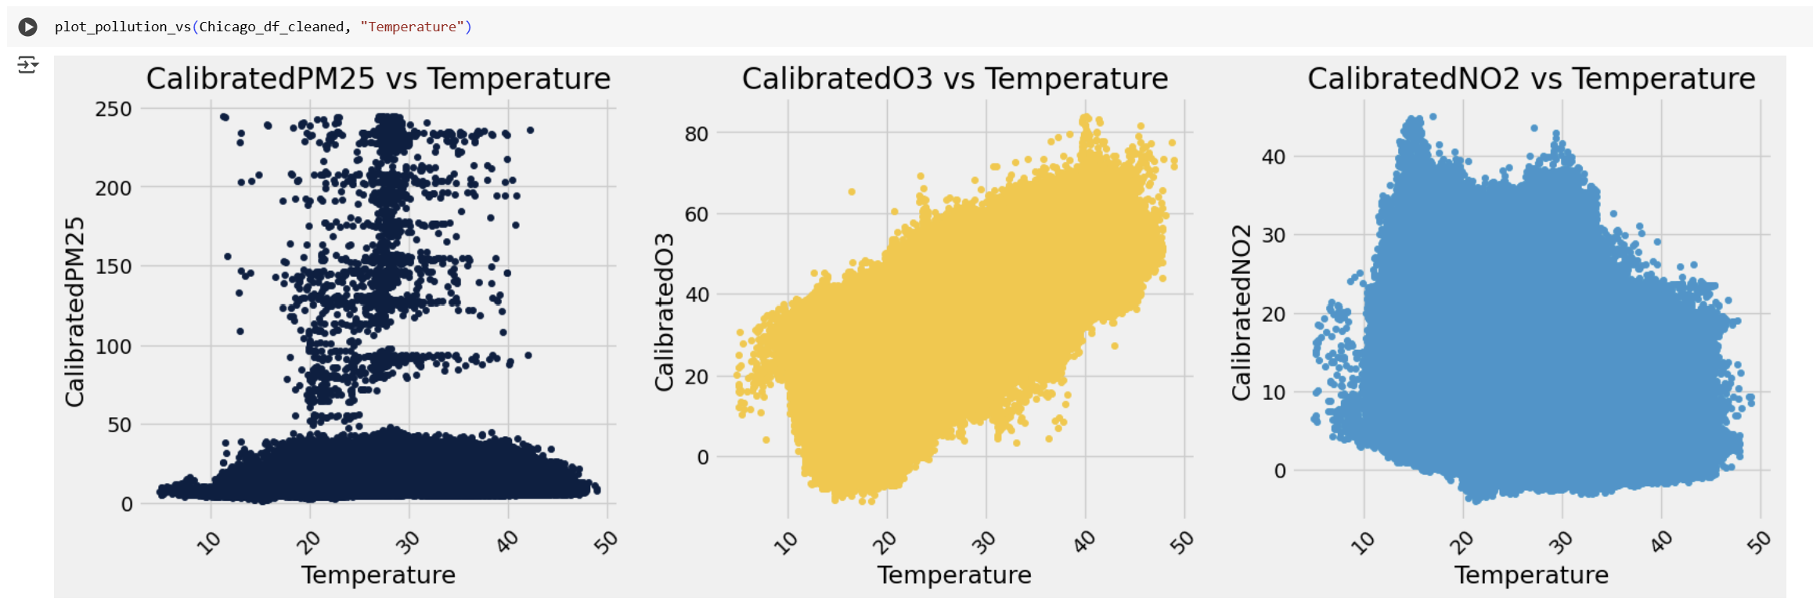
Results

Slide 8
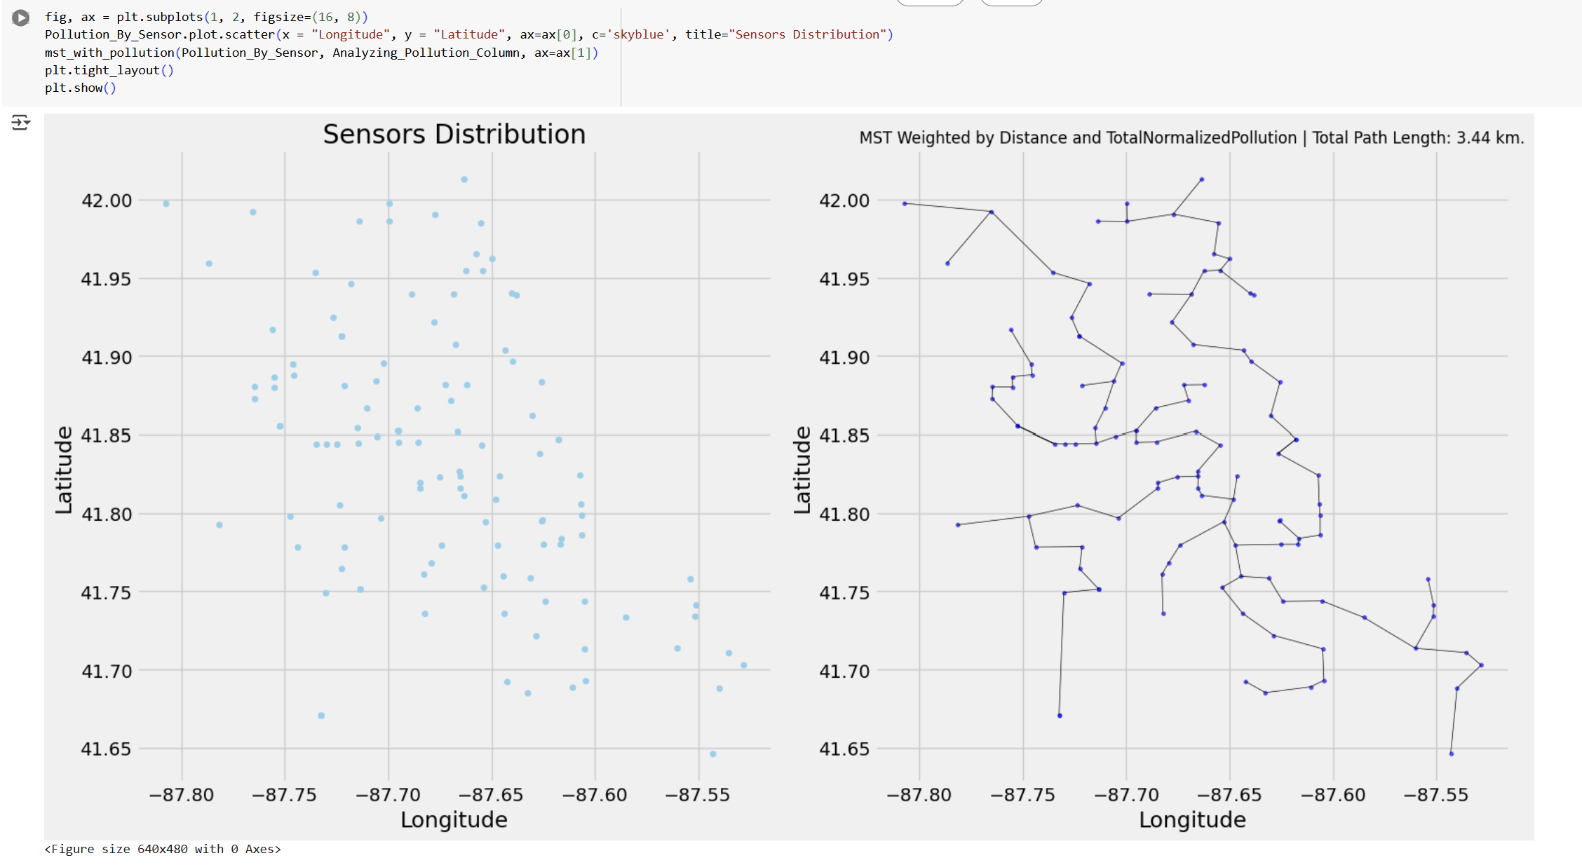
Results

Slide 9
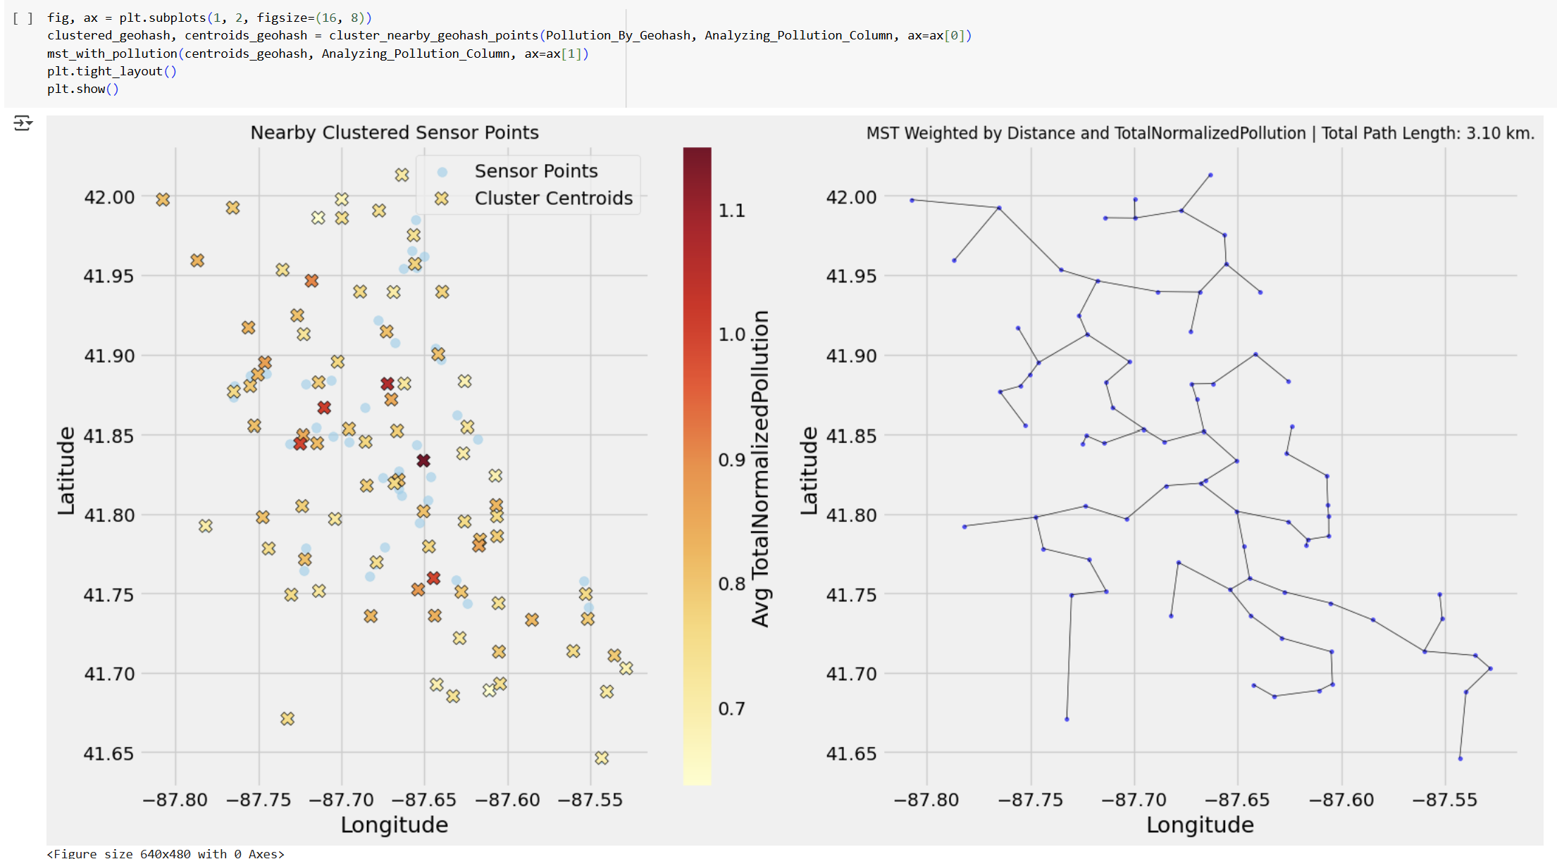
Results

Slide 10
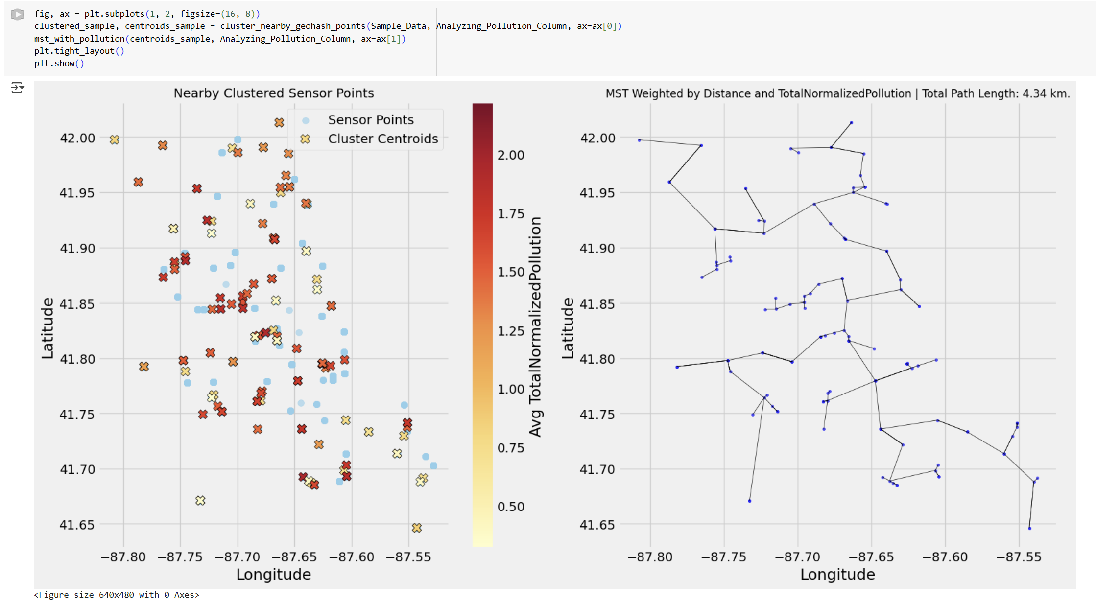
Results

Slide 11
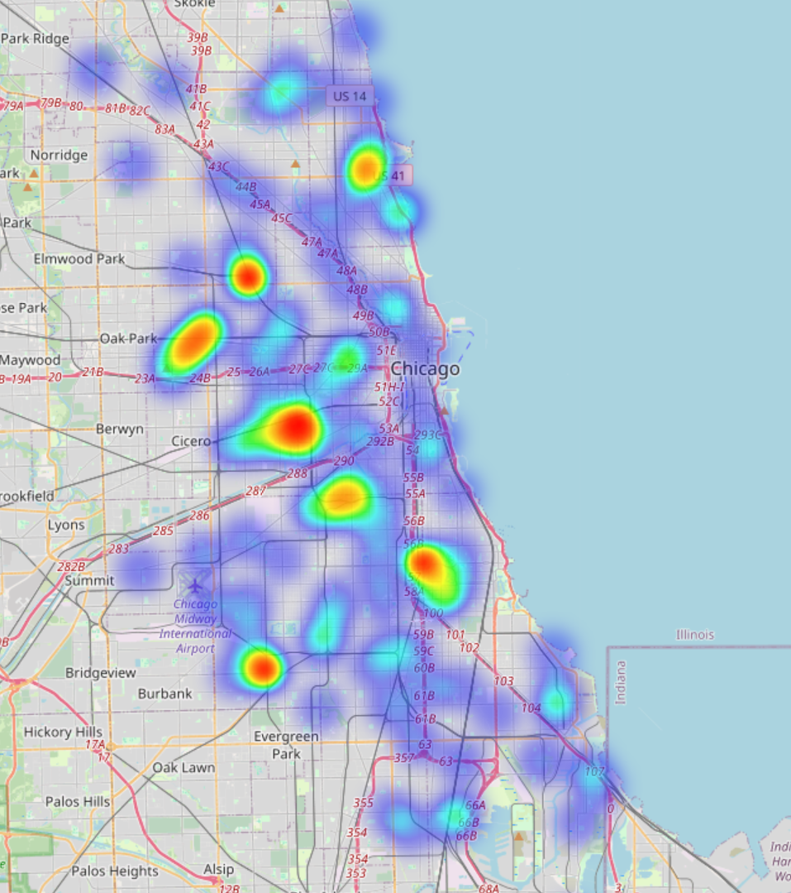
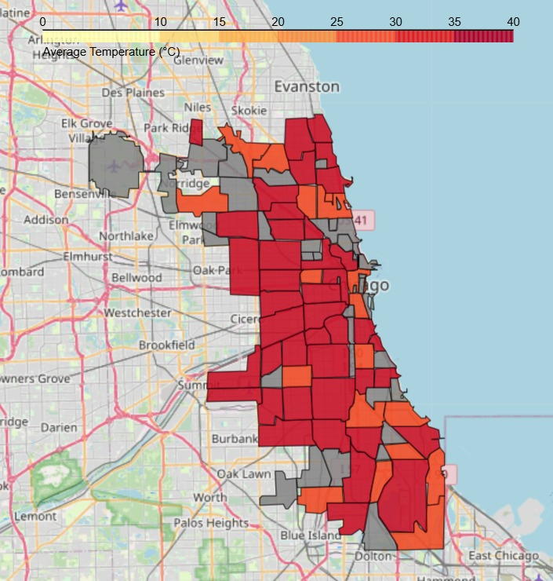
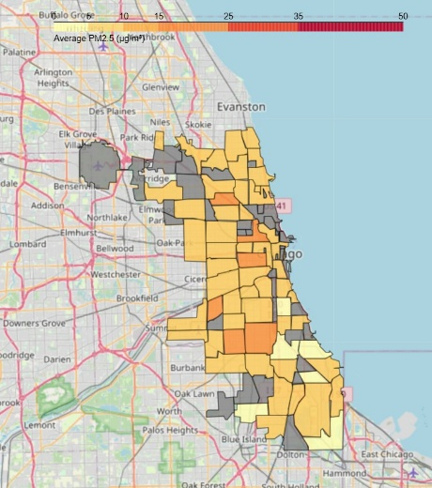
Results
heatmap of temperature
temperature
average PM2.5 concentration levels

Slide 12
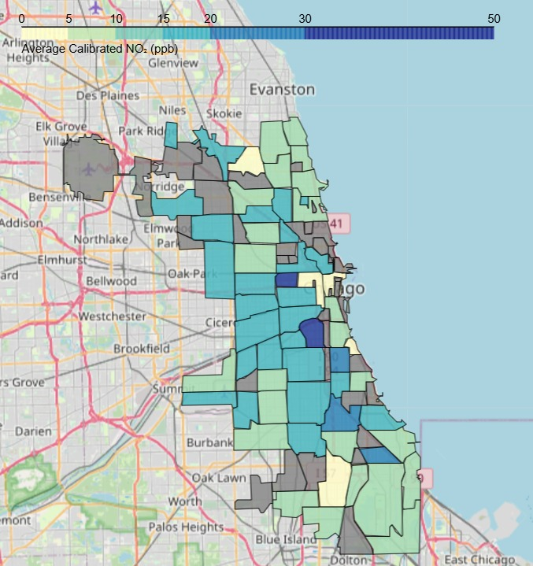
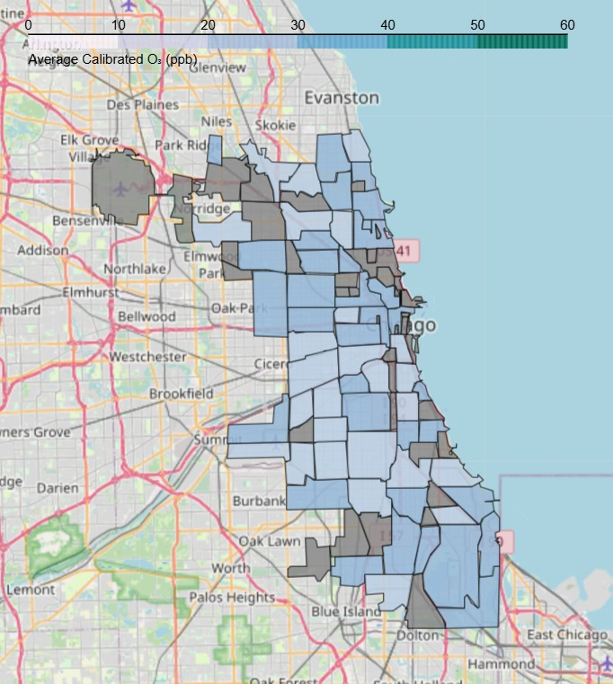
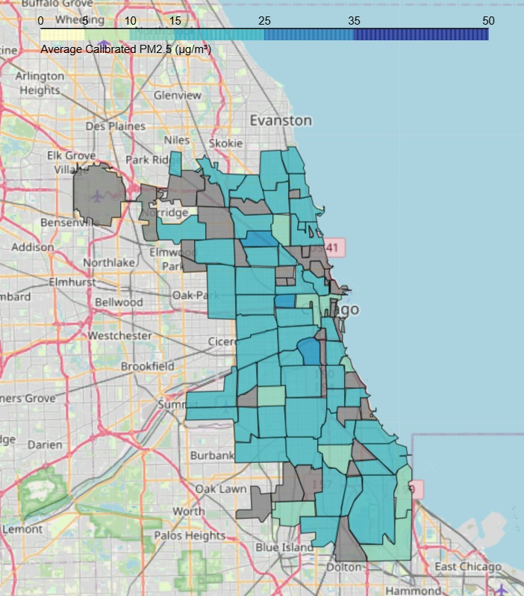
Results
Calibrated NO₂
Calibrated O₃
Calibrated PM2.5

Slide 13
Summary
Analyze spatial pollution data to optimize monitoring networks through MST
Strategy to generate cost-efficient routing:
Grouping by geohash
Cluster by pollution and nearby points
Minimum spanning tree by pollution and centroid points
Suggest Sensor Optimization

Slide 14
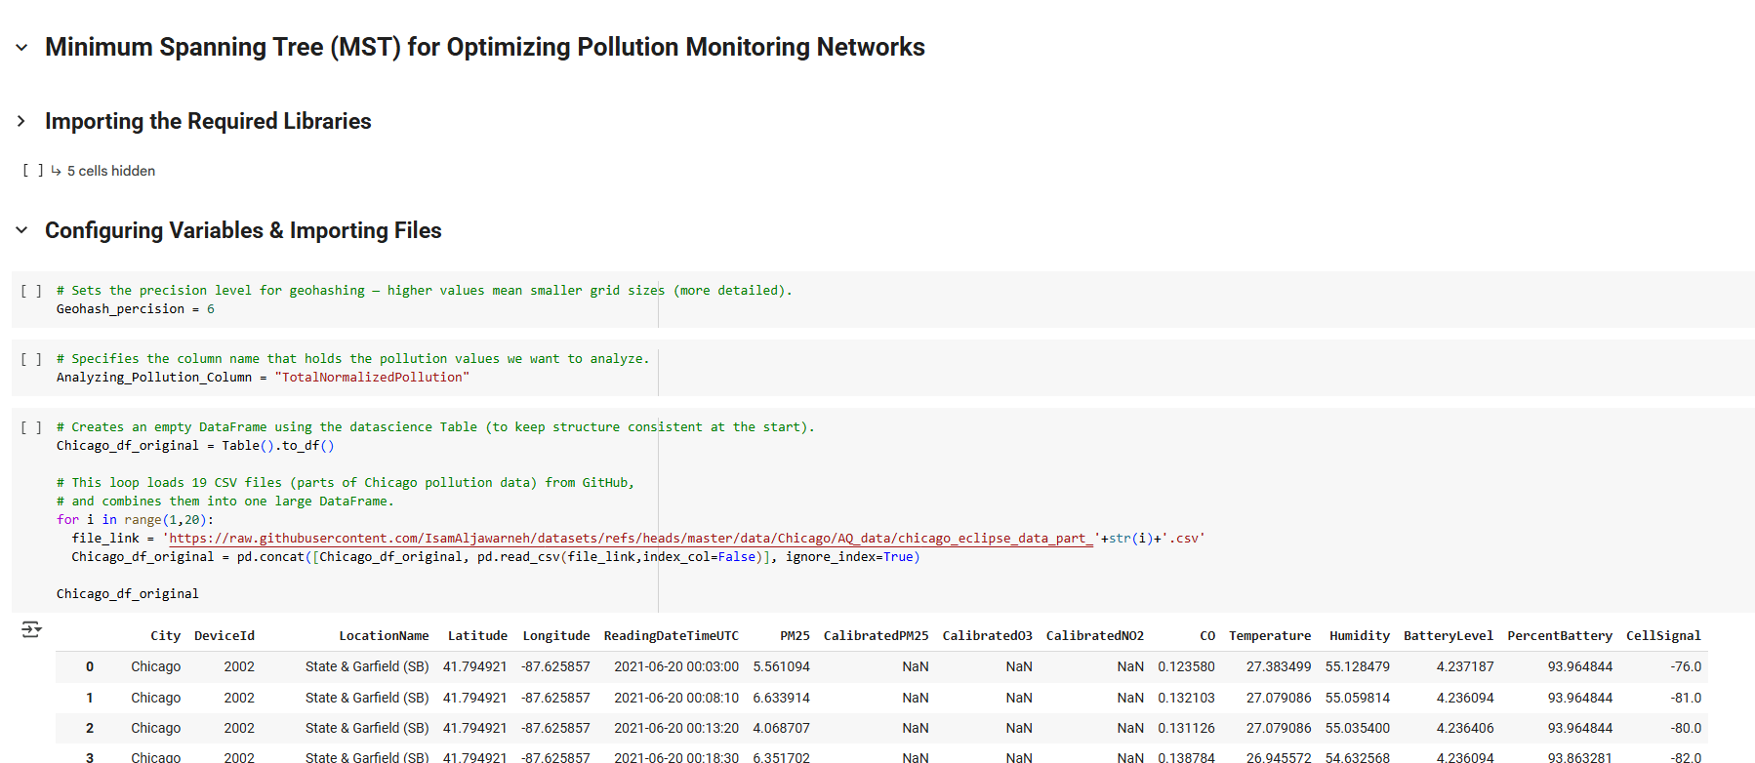
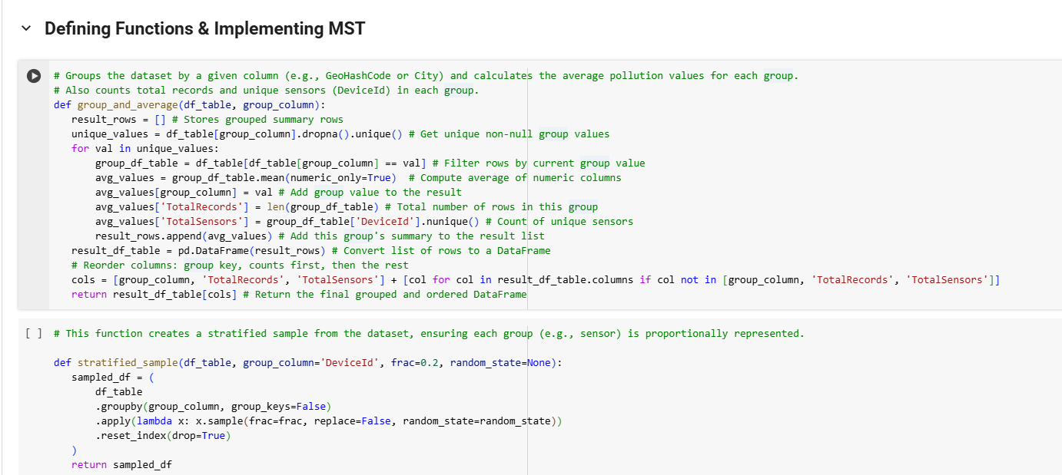
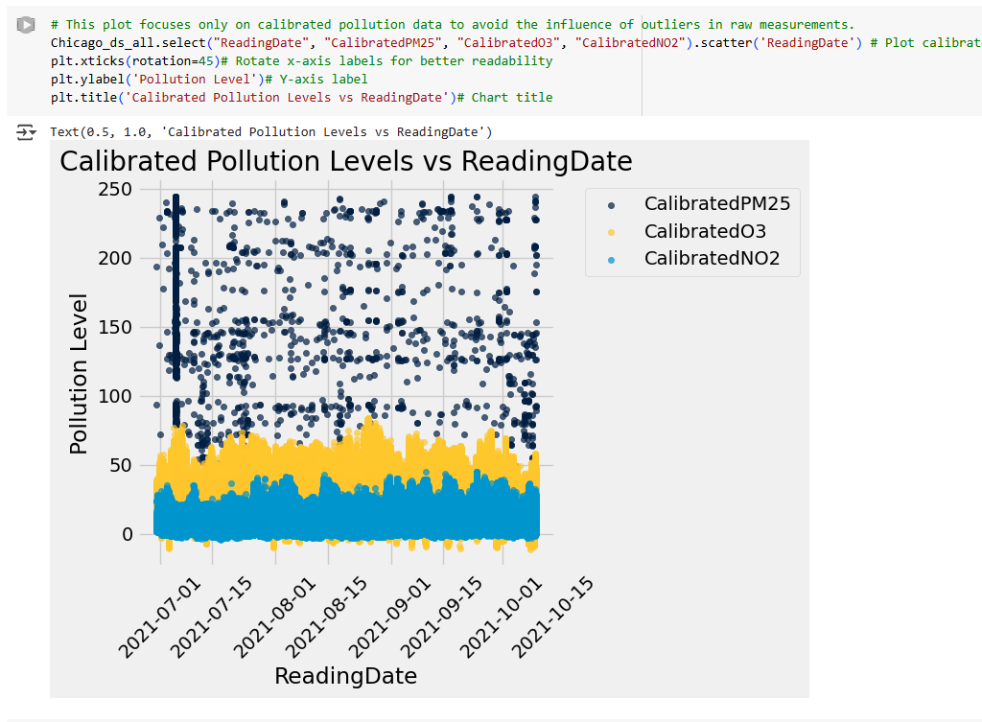
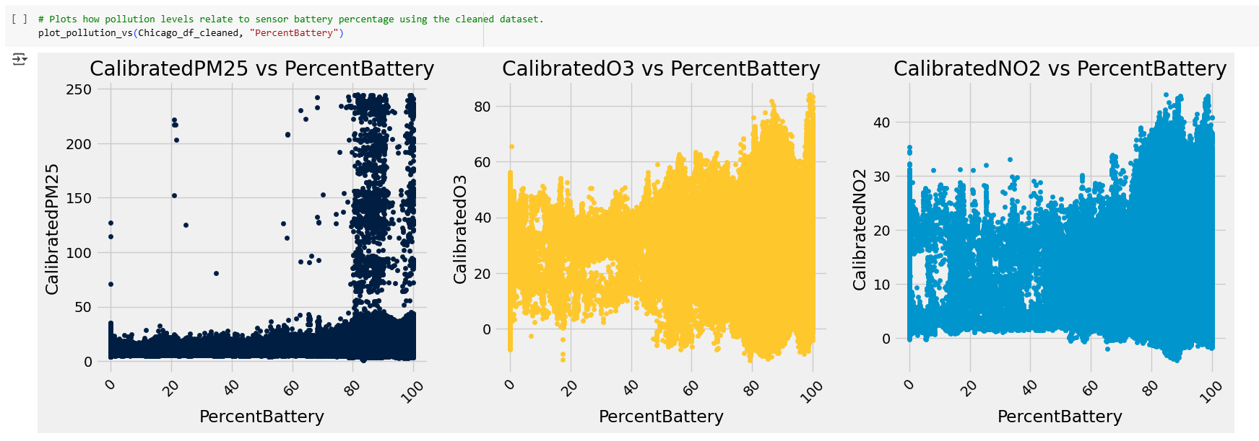
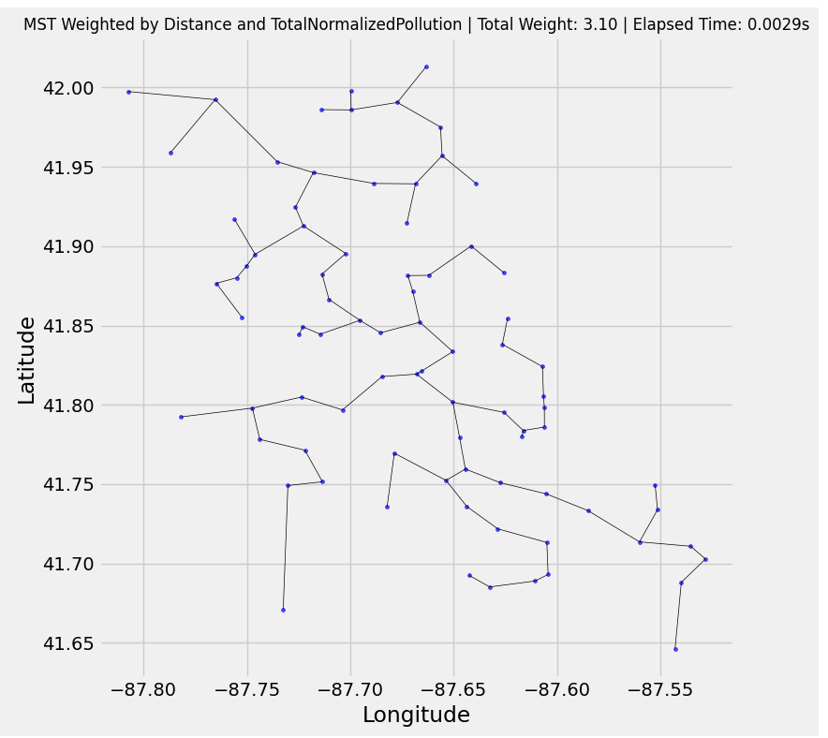
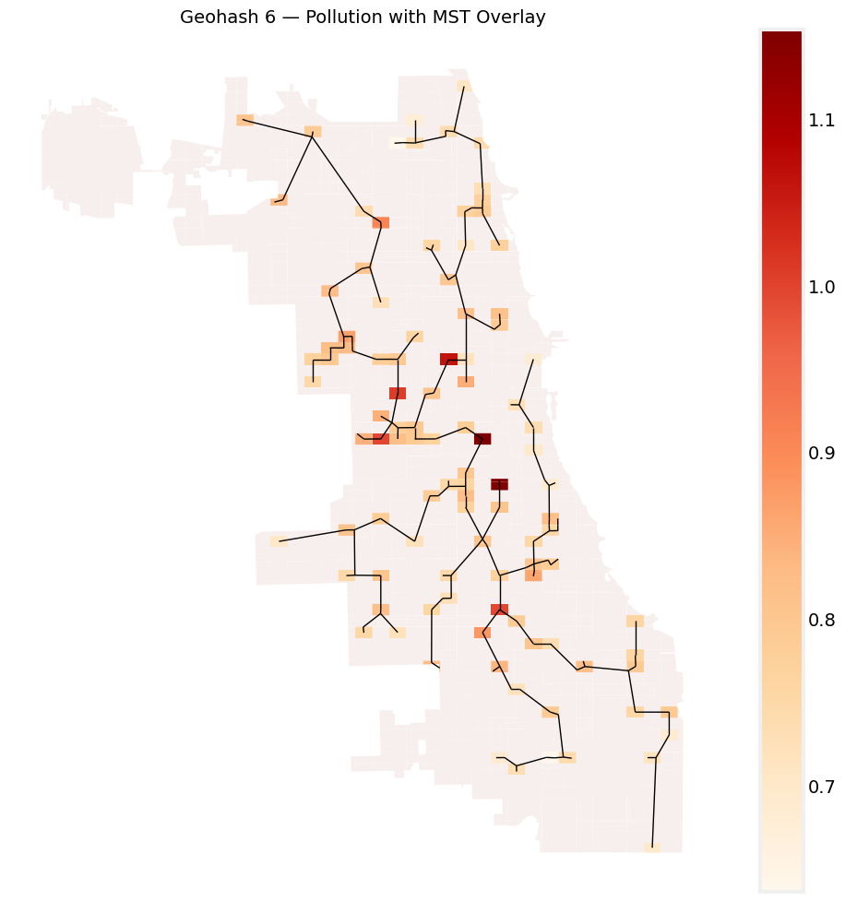
Codes - Aaesha
Collecting data and generating geohash codes
Analyzing the effects of environmental data
Grouping and sampling data
Minimum spanning tree
Sensors optimizing suggestion
Geohash gridding map with MST

Slide 15
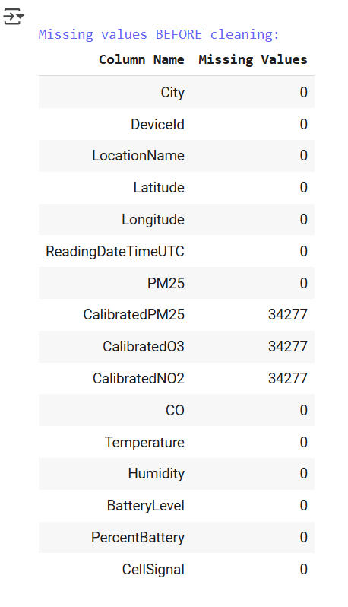
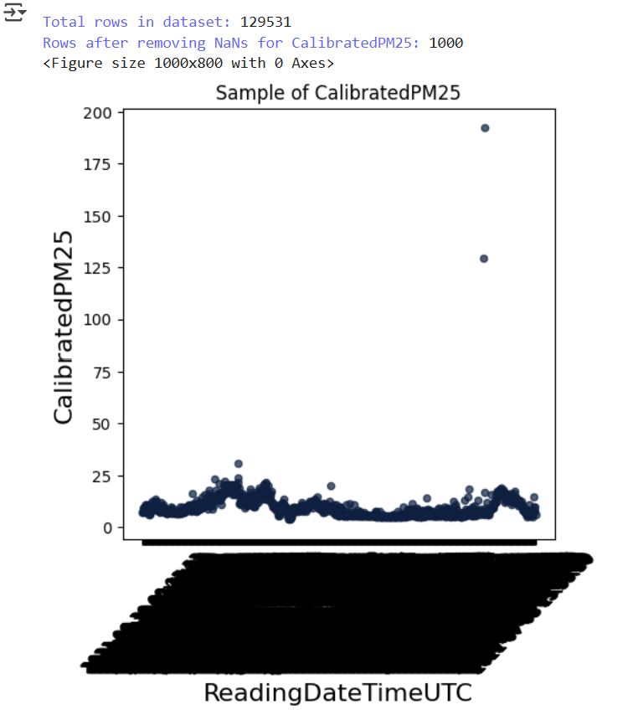
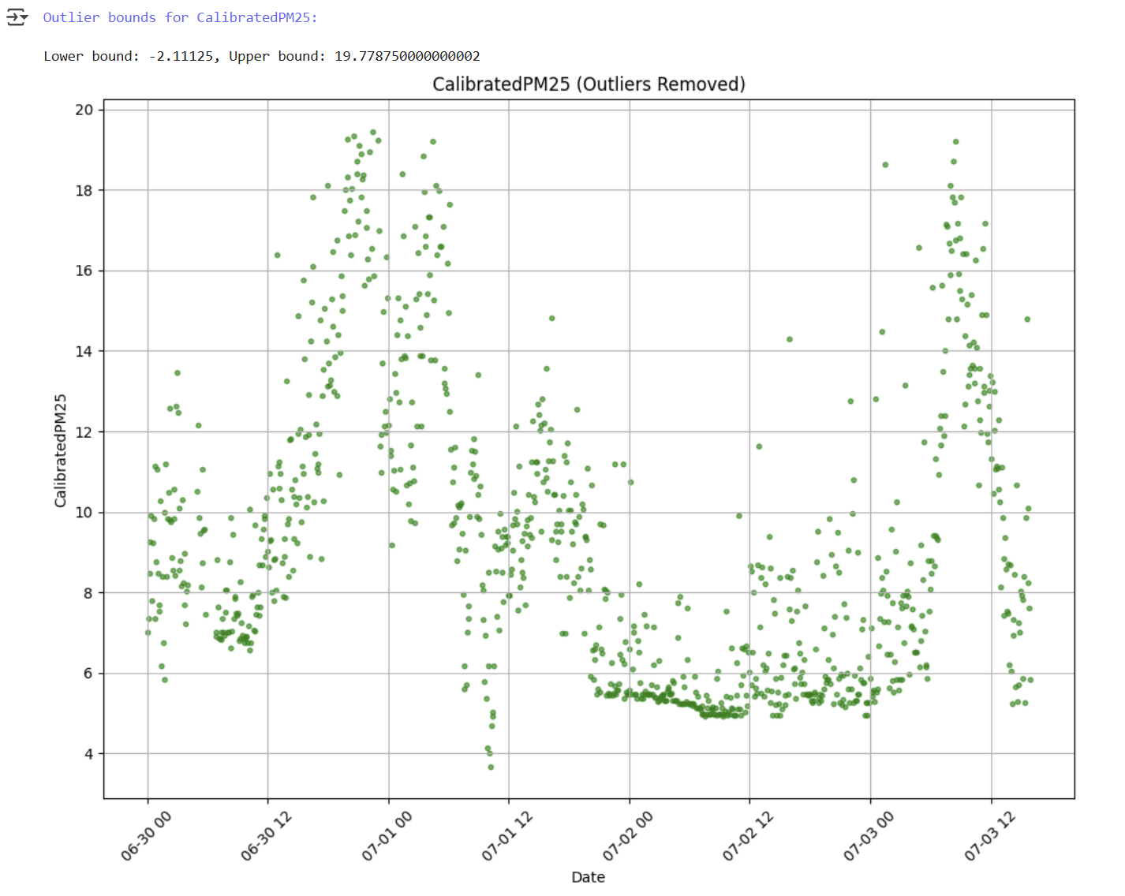
Codes - Ahuod
Data Loading
Initial Exploration
Missing Value Analysis
Data Cleaning
Data Visualization (Before outlier removal)
Outlier Detection & Removal
3.
5.
6.

Slide 16
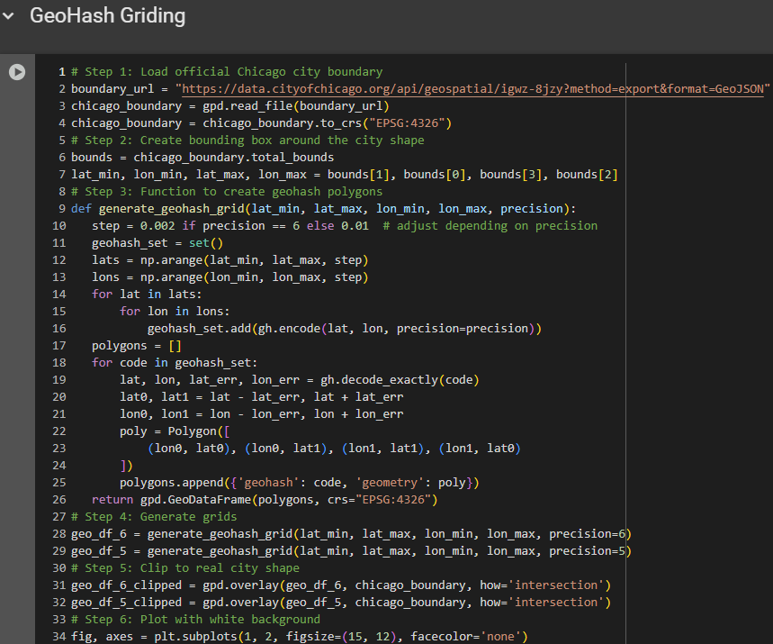
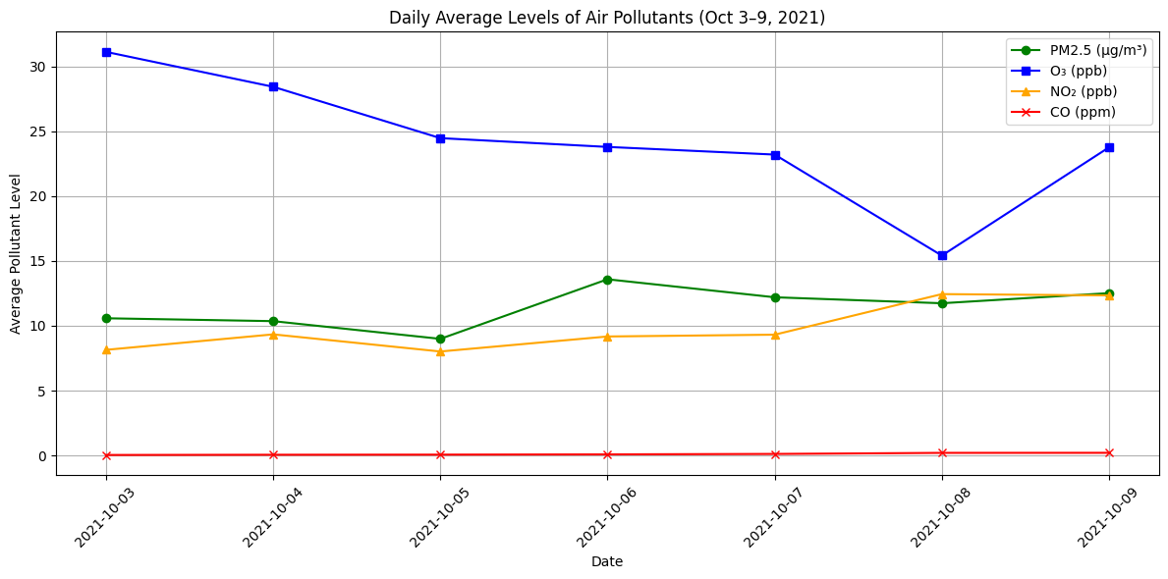
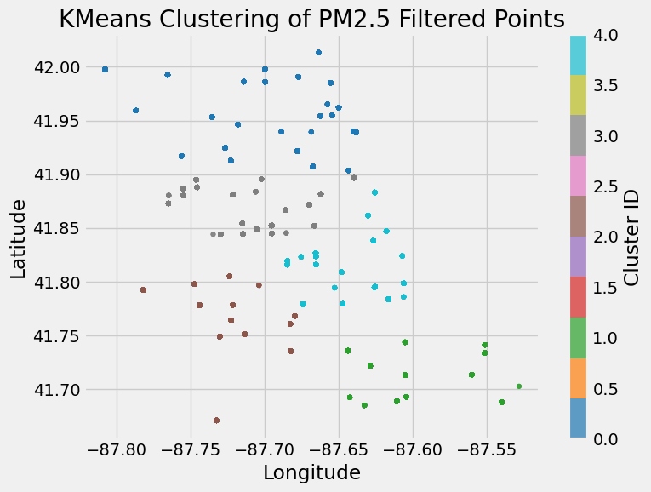
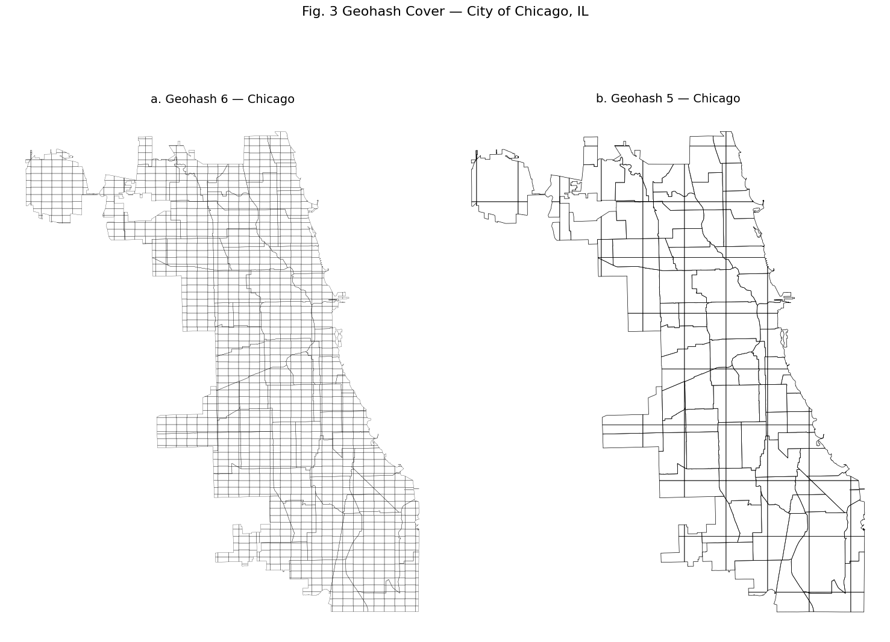
Codes - Kulsum
Seasonal Trend
K-Means
Clustering & Centriods
Geohash Griding (Map)
Code( Comments)

Slide 17
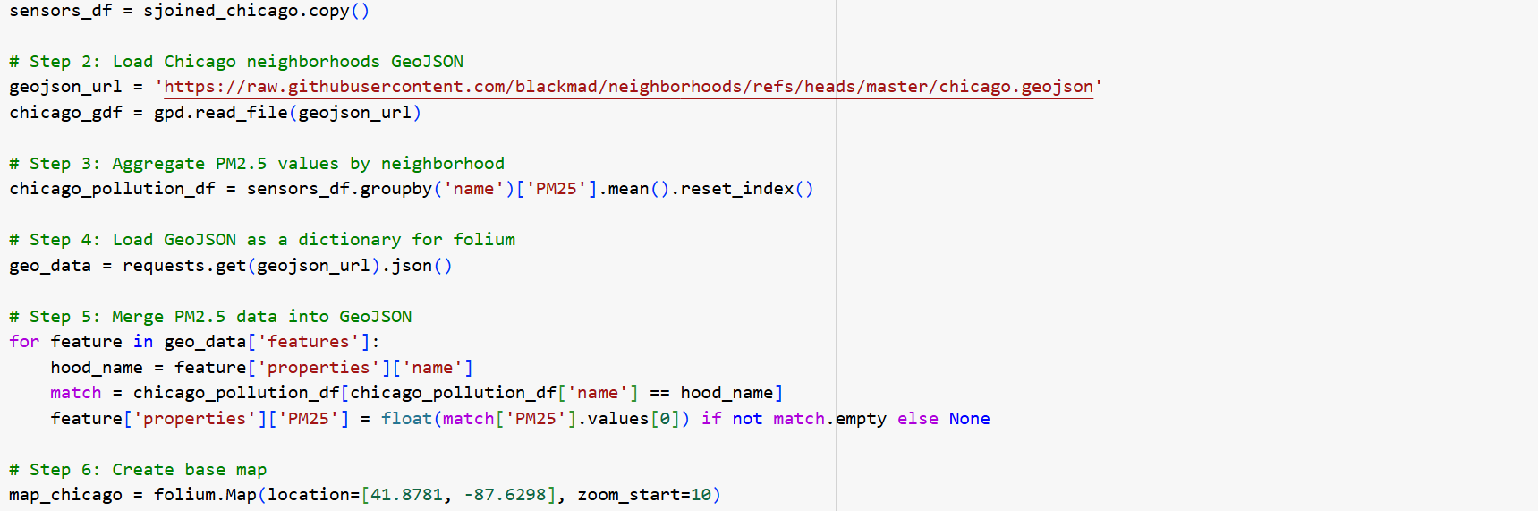
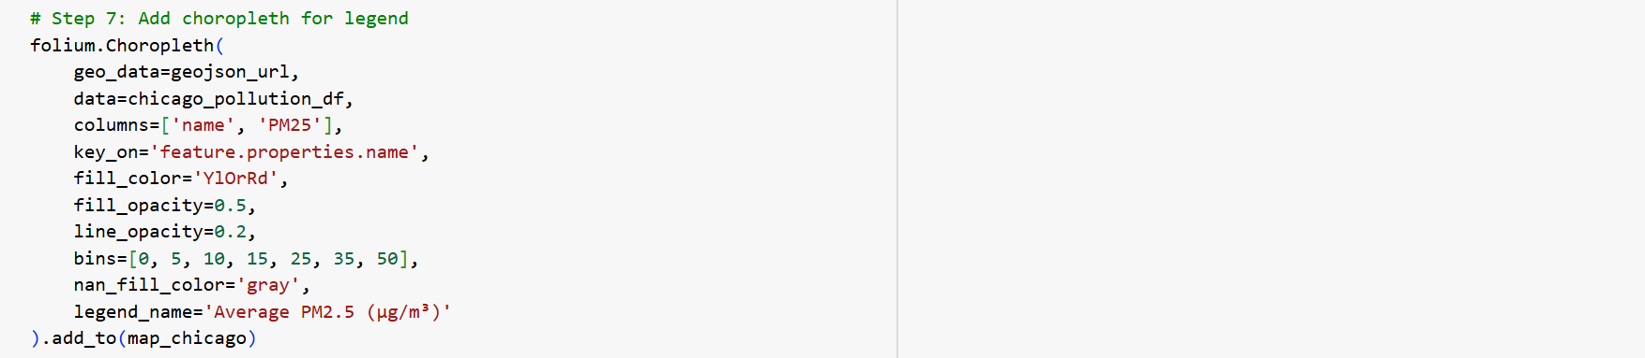
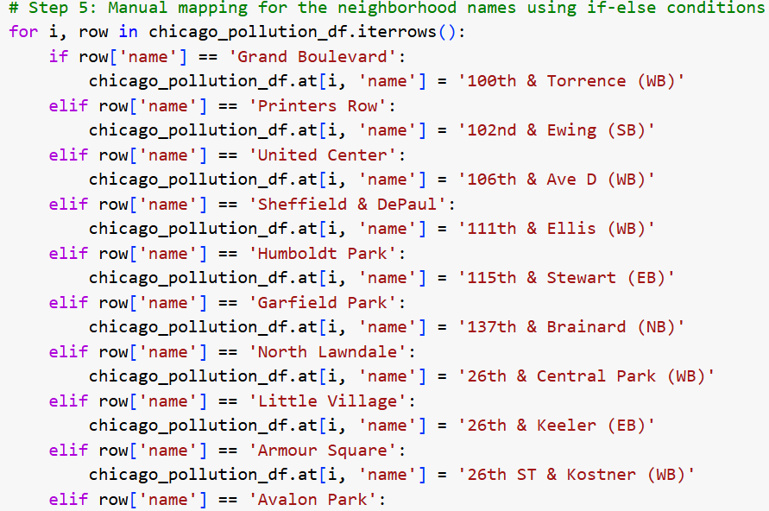
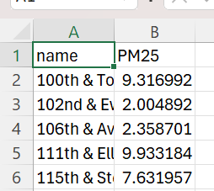
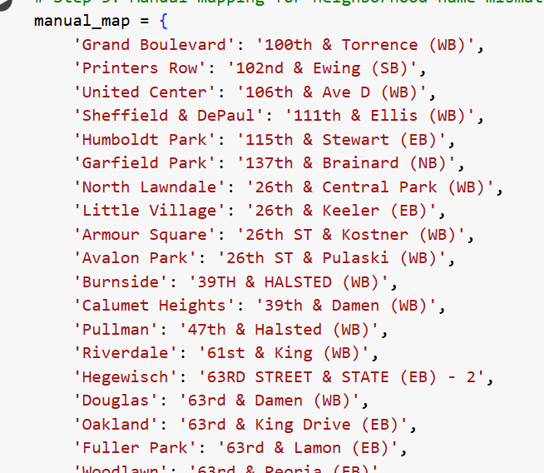
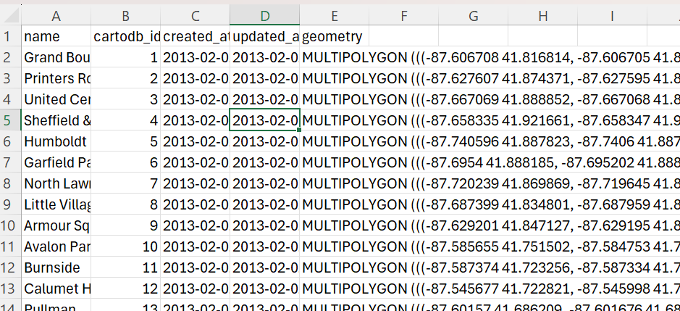
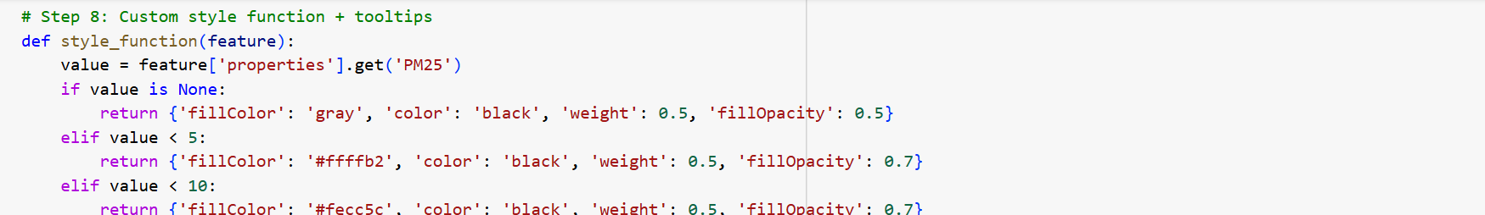
Codes – Ghalya:
code demonstrations “Maps”
Mismatch Between Data and GeoJSON

Slide 18
Contribution
Tiles | Contributor Names
Abstract | Ahuod (High)
Introduction | Ahuod (High)
Related literature | Ahuod (High) , Kulsum (High) , Ghalya (High)
Methodology | Aaesha (High), Ahuod (Low), Kulsum (Medium) , Ghalya (Low)
Results and Discussion | Aaesha (High), Ahuod (High)
Summary and future work | Aaesha (High), Ahuod (High) , Kulsum (High)
Compiling report | Aaesha (High) , Kulsum (High), Ghalya (High), Ahuod (High)
PPT | Aaesha (High), Ahuod (High) , Kulsum (High), Ghalya (High)
Code | Aaesha (High), Ahuod (Medium), Kulsum (High), Ghalya (Medium)

Slide 19

Commits Contributions

Slide 20


Contribution - Aaesha

Slide 21
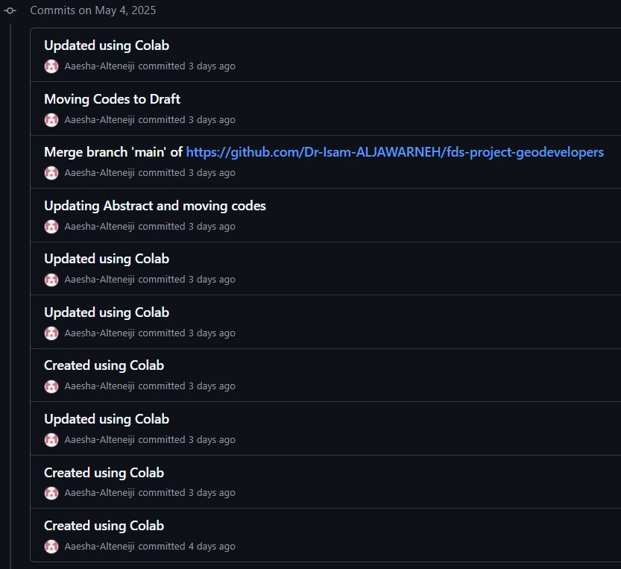

Contribution - Aaesha

Slide 22
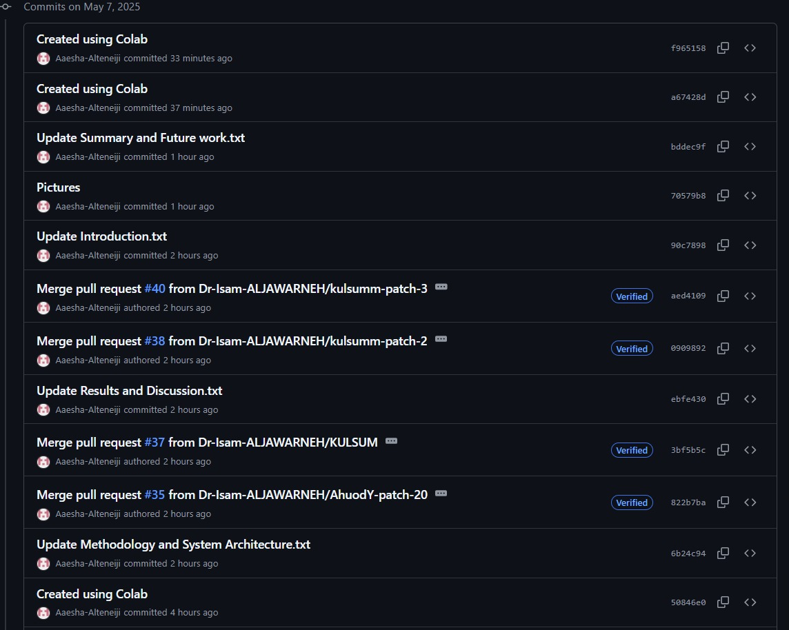
Contribution - Aaesha

Slide 23


Contribution - Ahuod

Slide 24


Contribution - Ahuod

Slide 25


Contribution - Ahuod

Slide 26

Contribution - Ahuod

Slide 27

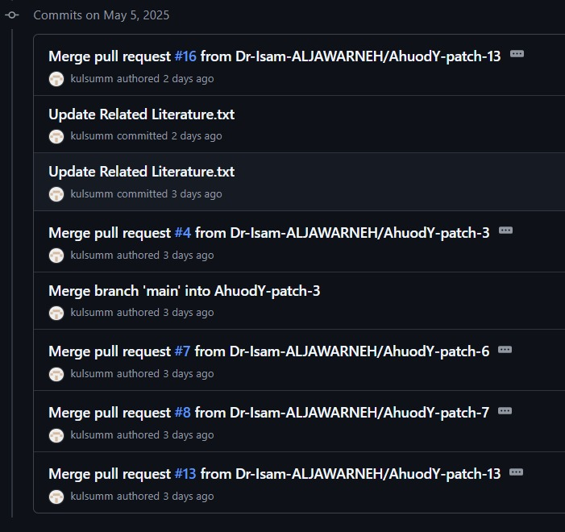
Contribution - Kulsum

Slide 28


Contribution - Kulsum

Slide 29

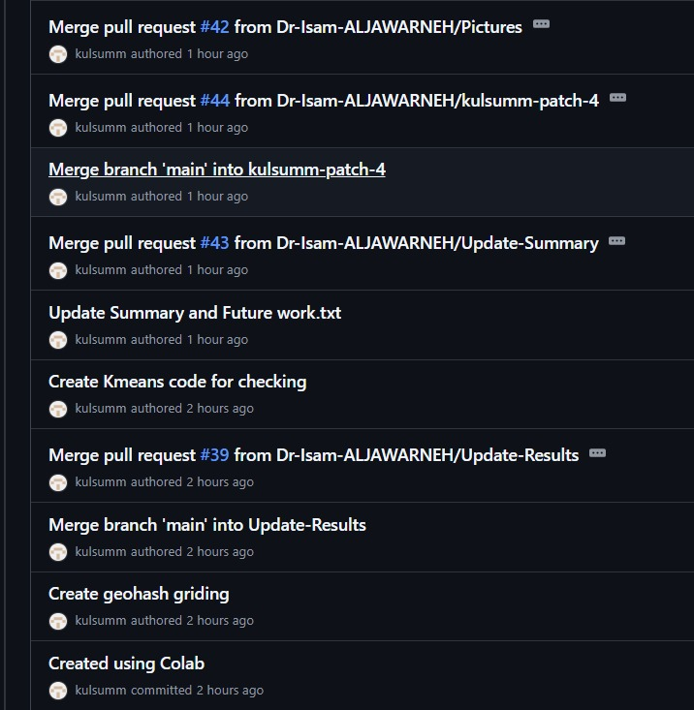
Contribution - Kulsum

Slide 30
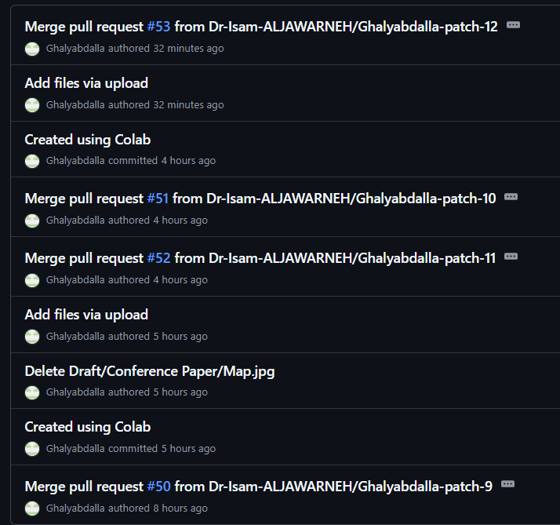

Contribution - Ghalya

Slide 31
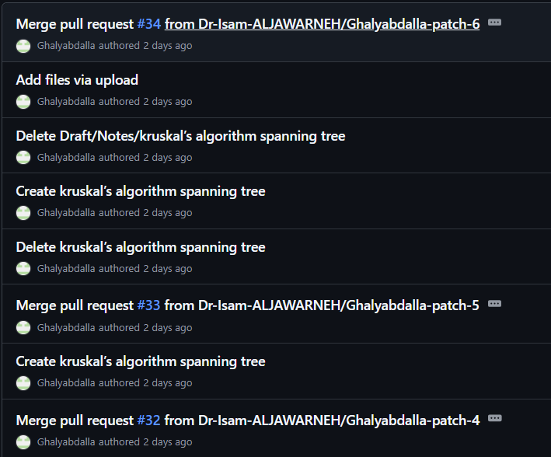
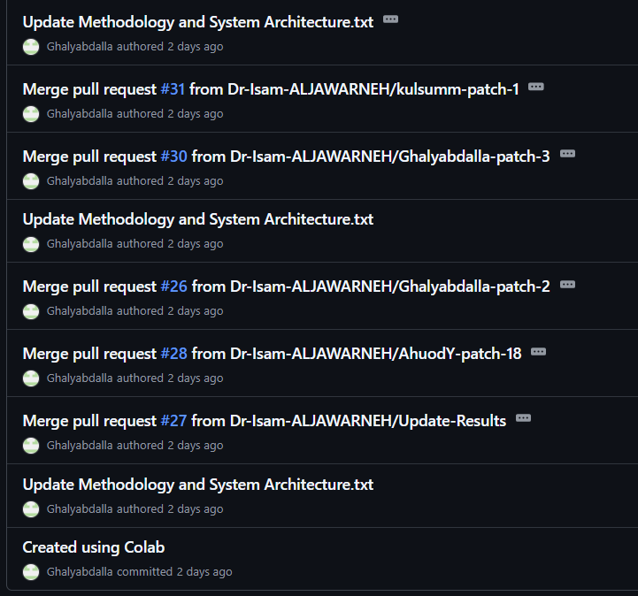
Contribution - Ghalya

Slide 32
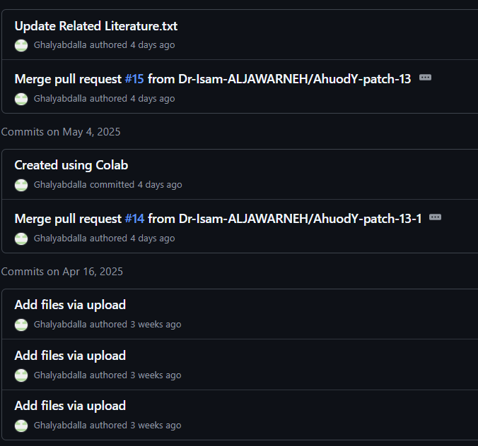

Contribution - Ghalya

